Slide 1
Computer Networks
COL 334/672
Data Plane
Slides adapted from KR
Sem 1, 2025-26

Slide 2

Quiz on Moodle (NOT Moodlenew)
bgp

Slide 3




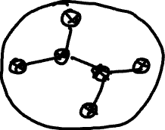
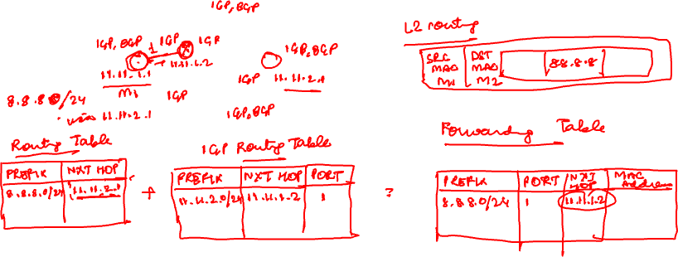

Story so far ..
Routing algorithms in the network layer
  Intra-domain routing through an interior gateway protocol such as OSPF, RIP
  Inter-domain routing through BGP
Now, completing the picture

Slide 4



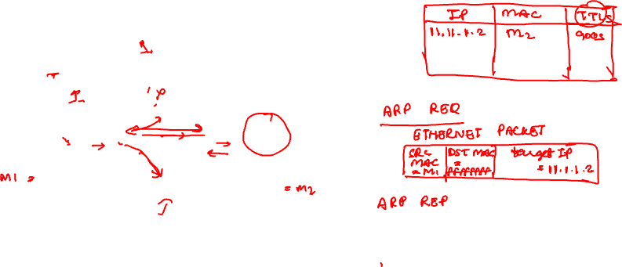
ARP: address resolution protocol
ARP: determines interface’s MAC address, knowing its IP address
ARP
11.1.1.4
1A-2F-BB-76-09-AD
ARP
ARP
LAN
71-65-F7-2B-08-53
58-23-D7-FA-20-B0
11.11.1.1
11.1.1.2
ARP
0C-C4-11-6F-E3-98
11.1.1.3

Slide 5

Putting it all together: Routing to another subnet
walkthrough: sending a datagram from A to B via R
  focus on addressing – at IP (datagram) and MAC layer (frame) levels
  assume that:
    A knows B’s IP address
    A knows IP address of first hop router, R (how?)
    A knows R’s MAC address (how?)
A
R
B
111.111.111.111
74-29-9C-E8-FF-55
222.222.222.222
49-BD-D2-C7-56-2A
222.222.222.220
1A-23-F9-CD-06-9B
111.111.111.112
111.111.111.110
CC-49-DE-D0-AB-7D
E6-E9-00-17-BB-4B
222.222.222.221
88-B2-2F-54-1A-0F

Slide 6
Routing to another subnet: addressing
A creates IP datagram with IP source A, destination B
A creates link-layer frame containing A-to-B IP datagram
  R's MAC address is frame’s destination
MAC src: 74-29-9C-E8-FF-55
MAC dest: E6-E9-00-17-BB-4B
IP
Eth
Phy
IP src: 111.111.111.111
IP dest: 222.222.222.222
A
R
B
111.111.111.111
74-29-9C-E8-FF-55
222.222.222.222
49-BD-D2-C7-56-2A
222.222.222.220
1A-23-F9-CD-06-9B
111.111.111.112
111.111.111.110
CC-49-DE-D0-AB-7D
E6-E9-00-17-BB-4B
222.222.222.221
88-B2-2F-54-1A-0F

Slide 7
Routing to another subnet: addressing
frame sent from A to R
frame received at R, datagram removed, passed up to IP
MAC src: 74-29-9C-E8-FF-55
MAC dest: E6-E9-00-17-BB-4B
IP src: 111.111.111.111
IP dest: 222.222.222.222
IP
Eth
Phy
IP src: 111.111.111.111
IP dest: 222.222.222.222
IP
Eth
Phy
A
R
B
111.111.111.111
74-29-9C-E8-FF-55
222.222.222.222
49-BD-D2-C7-56-2A
222.222.222.220
1A-23-F9-CD-06-9B
111.111.111.112
111.111.111.110
CC-49-DE-D0-AB-7D
E6-E9-00-17-BB-4B
222.222.222.221
88-B2-2F-54-1A-0F

Slide 8
Routing to another subnet: addressing
R determines outgoing interface, passes datagram with IP source A, destination B to link layer
R creates link-layer frame containing A-to-B IP datagram. Frame destination address: B's MAC address
MAC src: 1A-23-F9-CD-06-9B
MAC dest: 49-BD-D2-C7-56-2A
IP
Eth
Phy
IP src: 111.111.111.111
IP dest: 222.222.222.222
A
R
B
111.111.111.111
74-29-9C-E8-FF-55
222.222.222.222
49-BD-D2-C7-56-2A
222.222.222.220
1A-23-F9-CD-06-9B
111.111.111.112
111.111.111.110
CC-49-DE-D0-AB-7D
E6-E9-00-17-BB-4B
222.222.222.221
88-B2-2F-54-1A-0F

Slide 9
Routing to another subnet: addressing
R determines outgoing interface, passes datagram with IP source A, destination B to link layer
R creates link-layer frame containing A-to-B IP datagram. Frame destination address: B's MAC address
MAC src: 1A-23-F9-CD-06-9B
MAC dest: 49-BD-D2-C7-56-2A
transmits link-layer frame
IP
Eth
Phy
IP
Eth
Phy
IP src: 111.111.111.111
IP dest: 222.222.222.222
A
R
B
111.111.111.111
74-29-9C-E8-FF-55
222.222.222.222
49-BD-D2-C7-56-2A
222.222.222.220
1A-23-F9-CD-06-9B
111.111.111.112
111.111.111.110
CC-49-DE-D0-AB-7D
E6-E9-00-17-BB-4B
222.222.222.221
88-B2-2F-54-1A-0F

Slide 10
Routing to another subnet: addressing
B receives frame, extracts IP datagram destination B
B passes datagram up protocol stack to IP
IP src: 111.111.111.111
IP dest: 222.222.222.222
IP
Eth
Phy
IP
Eth
Phy
A
R
B
111.111.111.111
74-29-9C-E8-FF-55
222.222.222.222
49-BD-D2-C7-56-2A
222.222.222.220
1A-23-F9-CD-06-9B
111.111.111.112
111.111.111.110
CC-49-DE-D0-AB-7D
E6-E9-00-17-BB-4B
222.222.222.221
88-B2-2F-54-1A-0F

Slide 11
IP addresses: how to get one?
How does host get IP address?
hard-coded by sysadmin in config file (e.g., /etc/rc.config in UNIX)
DHCP: Dynamic Host Configuration Protocol: dynamically get address from a server
  “plug-and-play”
  consists of a server running over UDP, responsible for assigning client IP address

Slide 12






DHCP client-server scenario
Typically, DHCP server will be co-located in router, serving all subnets to which router is attached
DHCP server
223.1.1.1
223.1.2.1
223.1.2.5
223.1.1.2
223.1.1.4
223.1.2.9
223.1.1.3
223.1.3.27
arriving DHCP client needs
address in this network
223.1.2.2
223.1.3.1
223.1.3.2

Slide 13


DHCP client-server scenario
DHCP server: 223.1.2.5
DHCP discover
Arriving client
src : 0.0.0.0, 68
dest.: 255.255.255.255,67
yiaddr: 0.0.0.0
transaction ID: 654
Broadcast: is there a DHCP server out there?
DHCP offer
Other information:
address of first-hop router for client
name and IP address of DNS sever
network mask (indicating network versus host portion of address)
src: 223.1.2.5, 67
dest: 255.255.255.255, 68
yiaddr: 223.1.2.4
transaction ID: 654
lifetime: 3600 secs
Broadcast: I’m a DHCP server! Here’s an IP address you can use
The two steps above can be skipped “if a client remembers and wishes to reuse a previously allocated network address” [RFC 2131]
DHCP request
src: 0.0.0.0, 68
dest:: 255.255.255.255, 67
yiaddr: 223.1.2.4
transaction ID: 655
lifetime: 3600 secs
Broadcast: OK. I would like to use this IP address!
DHCP ACK
src: 223.1.2.5, 67
dest: 255.255.255.255, 68
yiaddr: 223.1.2.4
transaction ID: 655
lifetime: 3600 secs
Broadcast: OK. You’ve got that IP address!

Slide 14

Recap
Network-layer functions:
routing: determine route taken by packets from source to destination
  routing algorithms
forwarding: move packets from a router’s input link to appropriate router output link
application
application
transport
transport
network
network
link
link
physical
physical

Slide 15
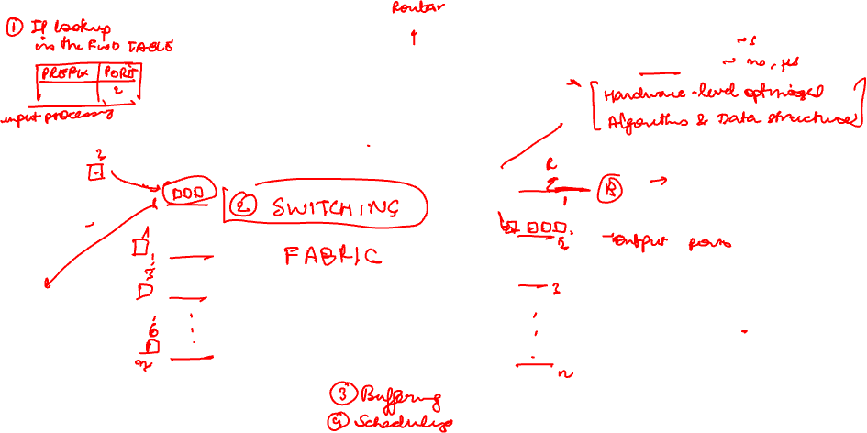









Router Architecture
Different time scales
Control plane:
Data plane:

Slide 16
Next Class: Data Plane Functions
IP lookup
Switching
Queuing
Scheduling

